Slide 1

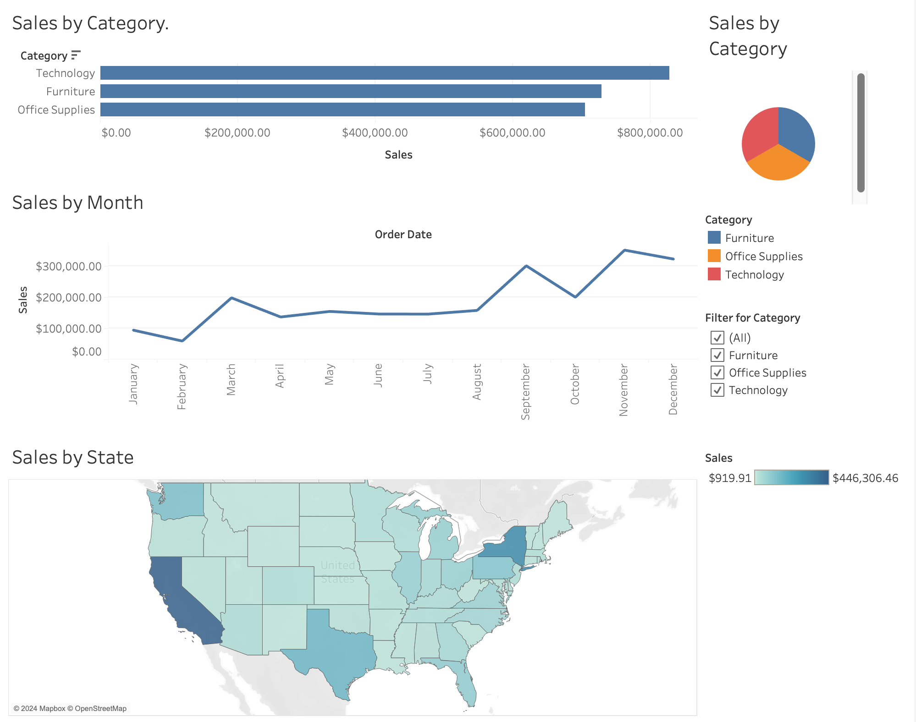
Superstore sales Tableau Project
Nathan Weir

Slide 2
Data preparation
The dataset used in this dashboard is synthetic sales data from an American business.
Before proceeding to Tableau visualization, the dataset underwent a thorough cleaning process in Excel:
Duplicate Removal: The entire dataset was subjected to the "Remove Duplicates" function to eliminate any redundant rows.
Null Value Elimination: Columns were individually filtered to identify and remove rows containing null values.
Date Format Standardisation: The "Order Date" and "Ship Date" columns were formatted to DD/MM/YYYY.
Data Type and Header Verification: Each column was inspected to ensure accurate data types and appropriate headers.
Text Data Refinement: Text columns were refined using the following Excel functions:
TRIM: Removed excess whitespace.
PROPER: Capitalised the first letter of each word.
CLEAN: Eliminated non-printable characters
Finally, I saved and loaded the dataset into Tableau for further analysis

Slide 3
Calculated field
I created a calculated field to show the sales contribution from each category as a percentage of total sales.
This was done using the following formula:
Percent of Total Sales = SUM([Sales])/TOTAL(SUM([Sales]))
This allowed me to explore further into which category is contributing the most towards total sales.

Slide 4
The Dashboard
The bar chart at the top shows the sales by category. We can see that the total sales are $2,261,537. Technology has the most sales, with $827k, furniture is second, with $729k, and Office supplies are last with $705k.
The pie chart on the right shows the same data but in a different format.
This tells us that technology makes up 37% of sales, with furniture at 32% and Office supplies at 31%.
The line chart shows us the sales trends over the year. November is the month with the highest sales at $350k, followed by December with $321k and September with $300k.
The Map shows us the sales by region, California has the highest sales with $446k, followed by New York with $306k and Texas with $169k.

Slide 5
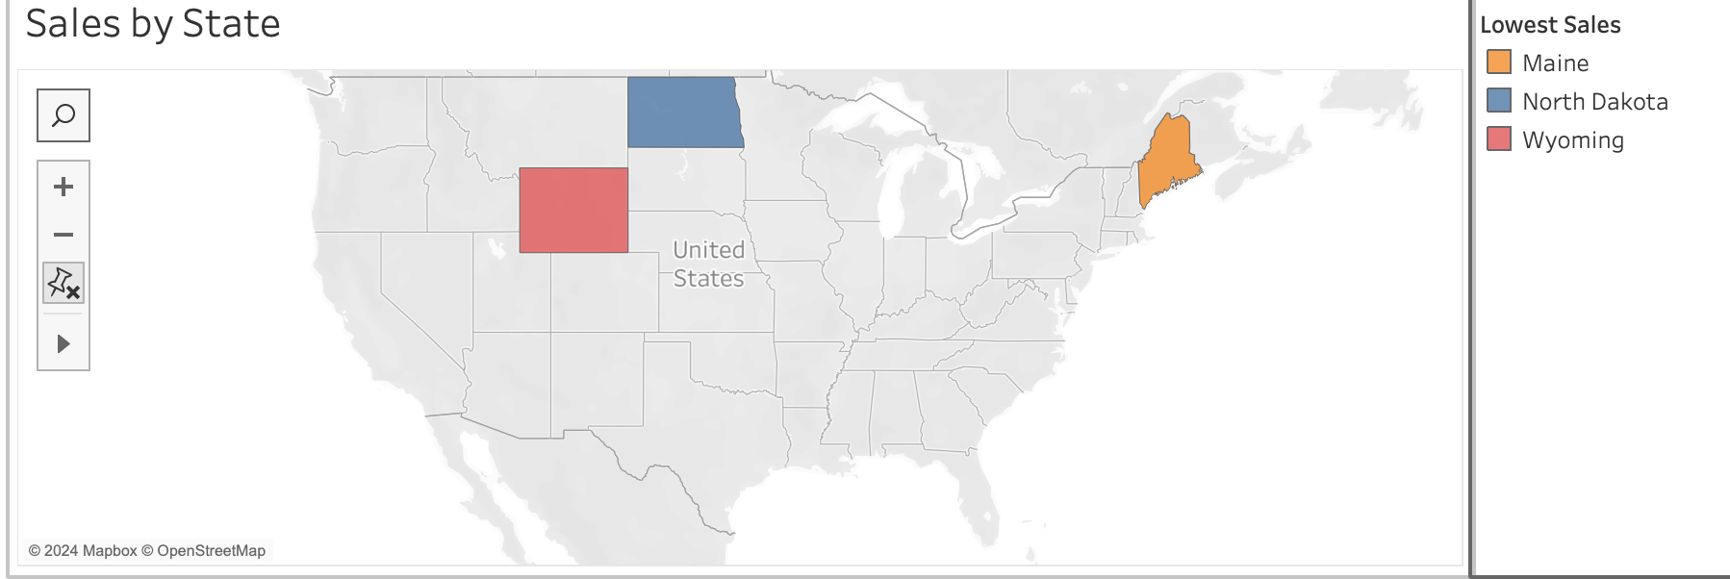
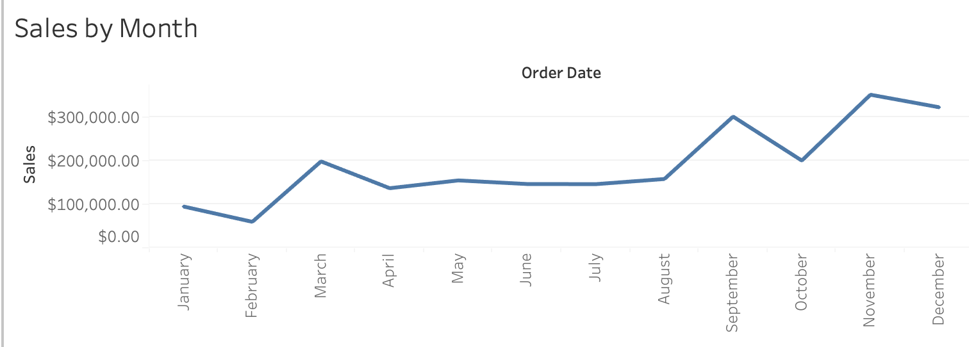
Further Insights
The map visualisation can effectively highlight regions with lower sales, enabling the business to develop targeted marketing strategies. For instance, total sales in North Dakota amounted to just $919, the lowest among all states. Investing more in marketing efforts for North Dakota, as well as other states like Maine, West Virginia, and Wyoming, could help boost overall sales.
The line chart indicates an overall positive trend in sales; however, a recurring pattern of sales decline emerges in the months following peak periods, specifically in April, October, and December. For sustained growth and continued sales increases, addressing this post-peak drop-off could prove beneficial for the business.

Slide 6
Conclusions
This dashboard provides valuable insights into key sales metrics, enabling the business to strategically address performance gaps and capitalise on growth opportunities.
By identifying underperforming states, the business can prioritise regions where additional marketing and outreach efforts may yield the most impact. Additionally, sales fluctuations throughout the year highlight periods of decline following peak sales months, suggesting that new strategies should be implemented in those months to stabilise performance.
Overall, a dashboard like this serves as a comprehensive overview, allowing decision-makers to pinpoint areas needing further analysis and take data-driven actions to optimize sales strategies year-round.

